Slide 1
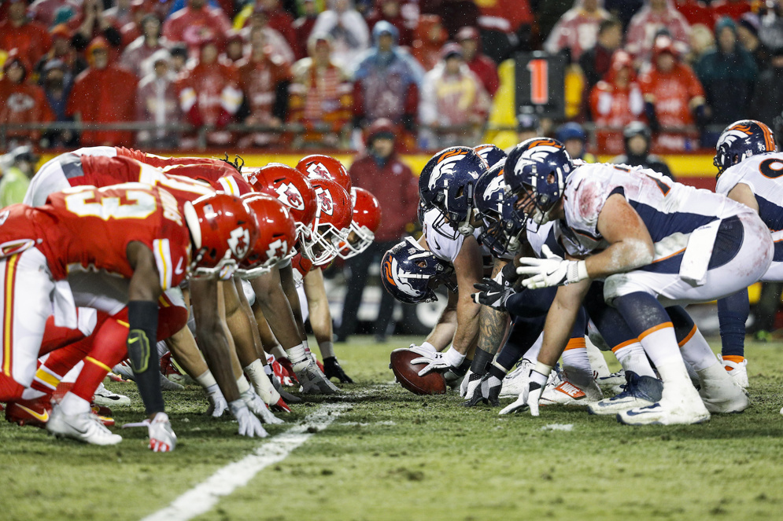

How Accurate are ESPN’s Fantasy Football Projections?
By John Incantalupo

Slide 2
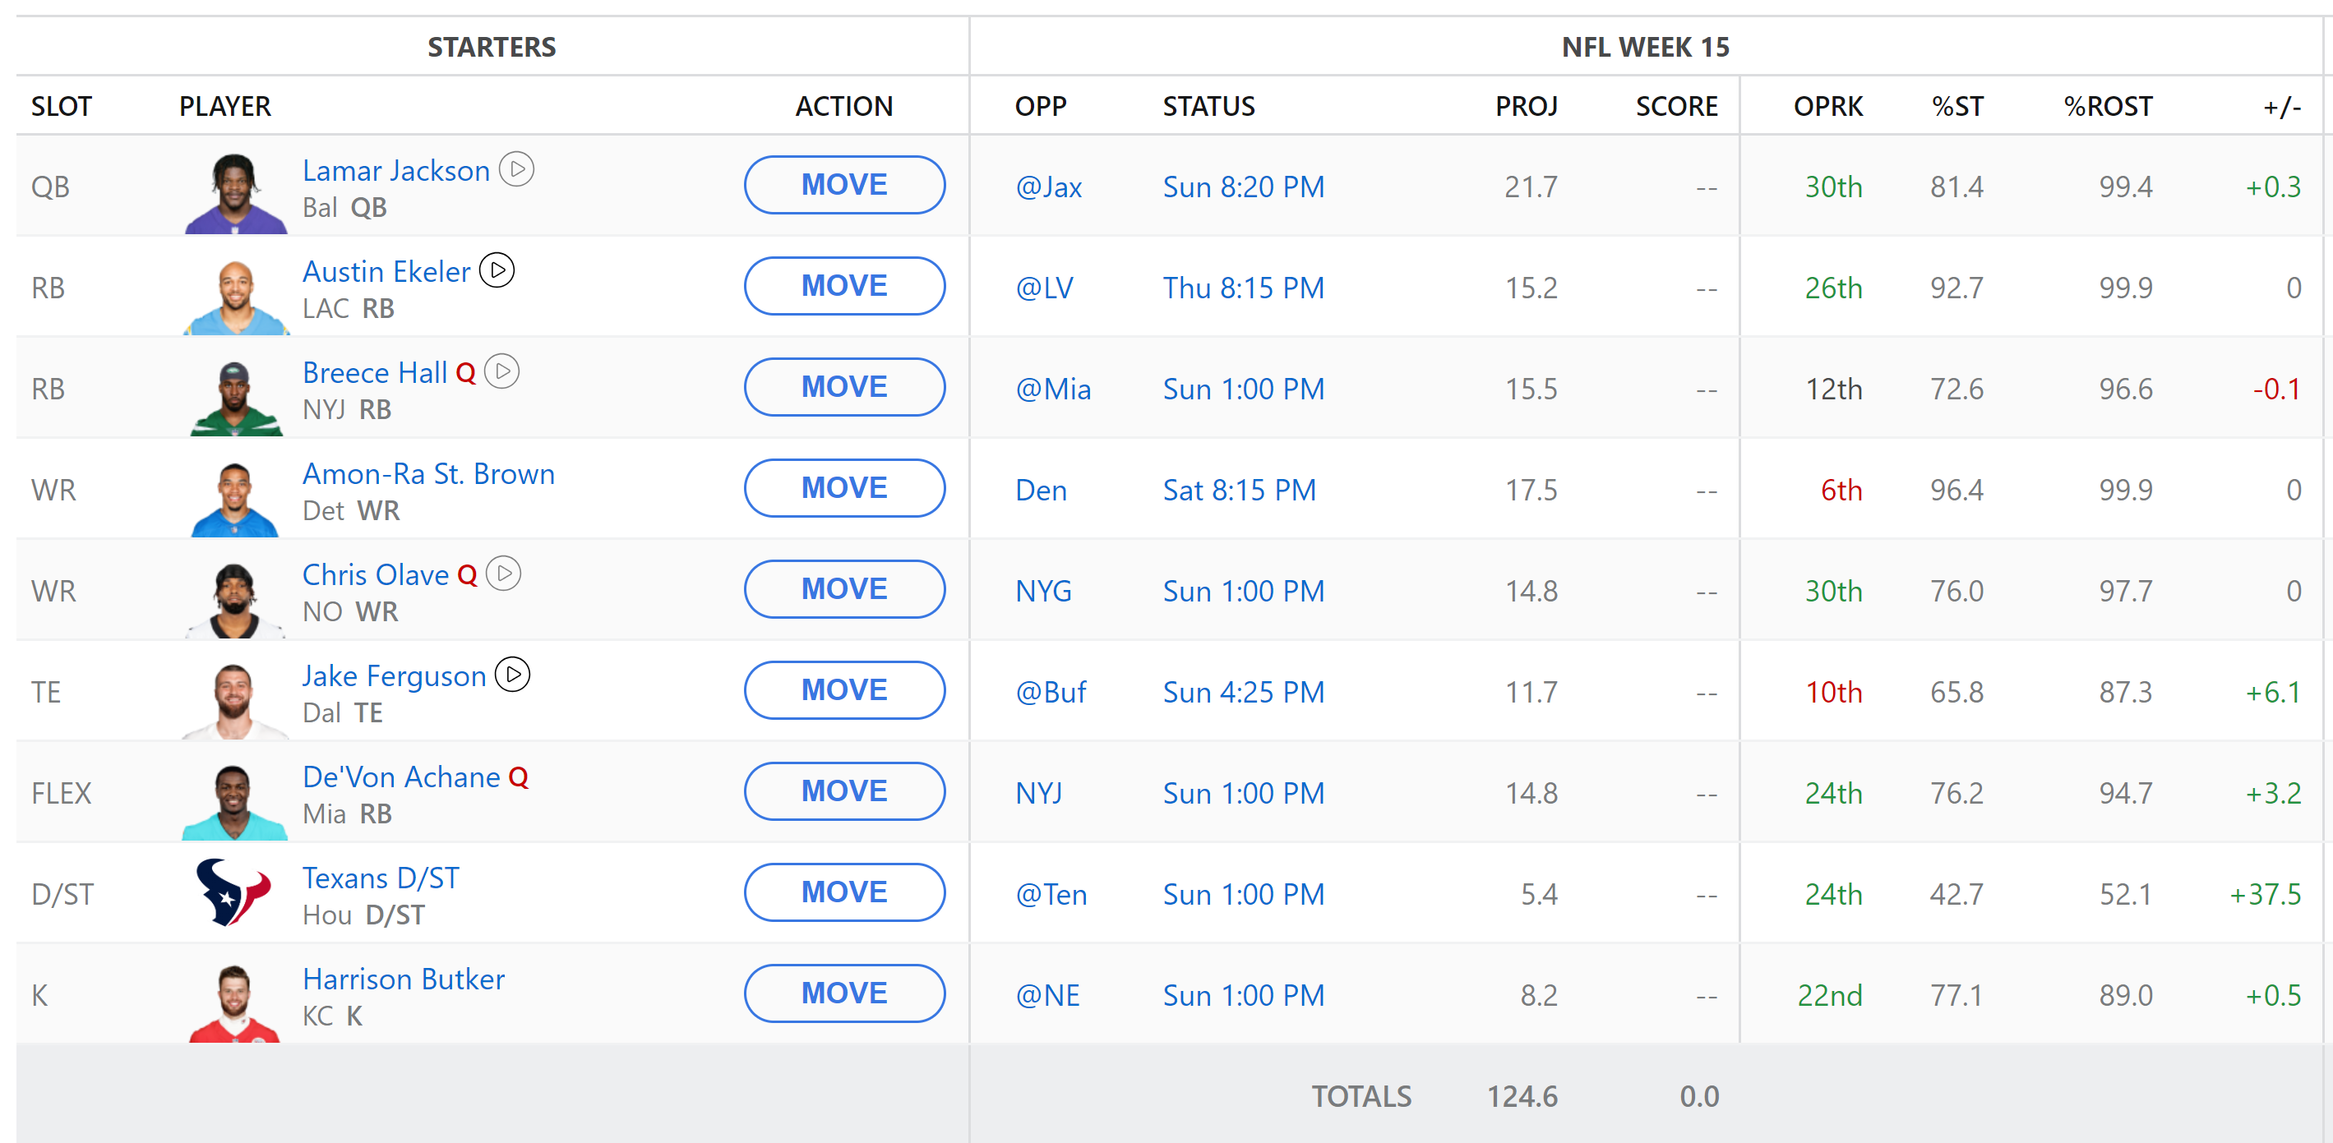
What is fantasy football?

Slide 3
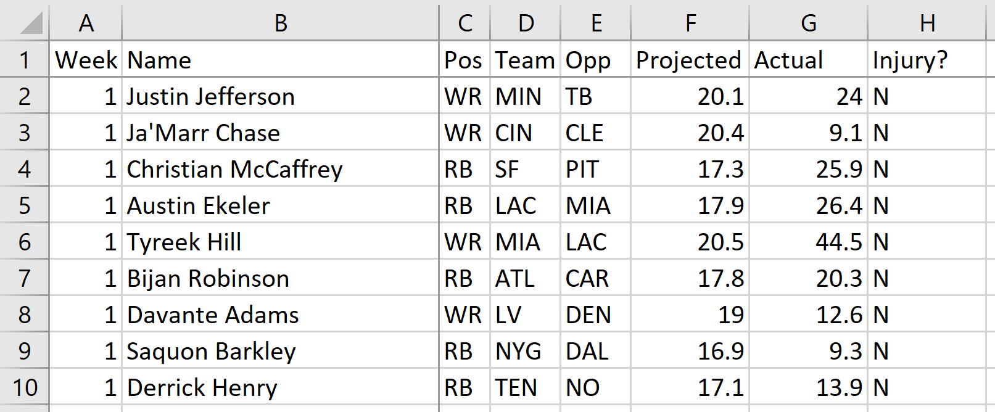
The Data

Slide 4
Setting Up the Data
Importing the Data and Factoring Attributes
Adding the Projection Error and Eliminating Injuries
scoring$Week <- factor(scoring$Week)
scoring$Name <- factor(scoring$Name)
scoring$Pos <- factor(scoring$Pos)
scoring$Team <- factor(scoring$Team)
scoring$Opp <- factor(scoring$Opp)
scoring$Injury. <- factor(scoring$Injury.)
week13$Week <- factor(week13$Week)
week13$Name <- factor(week13$Name)
week13$Pos <- factor(week13$Pos)
week13$Team <- factor(week13$Team)
week13$Opp <- factor(week13$Opp)
scoring %>%
mutate(Proj_error = Actual - Projected)
-> scoring
scoring %>%
filter(Injury. != 'Y') -> scoring_no_inj
scoring_no_inj[, -8] -> scoring_no_inj
scoring_no_inj$Name <- factor(scoring_no_inj$Name)

Slide 5
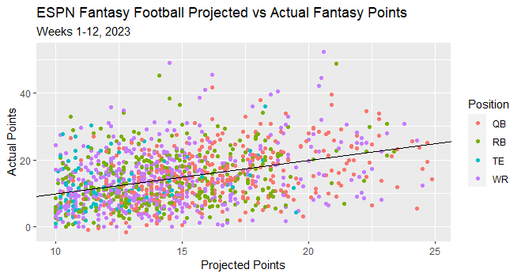
ggplot(scoring_no_inj, aes(Projected, Actual, color = Pos)) + geom_point() +
labs(x = "Projected Points", y = "Actual Points", color = "Position") +
ggtitle("ESPN Fantasy Football Projected vs Actual Fantasy Points", subtitle = "Weeks 1-12, 2023") +
geom_abline(slope = 1, intercept = 0)

Slide 6
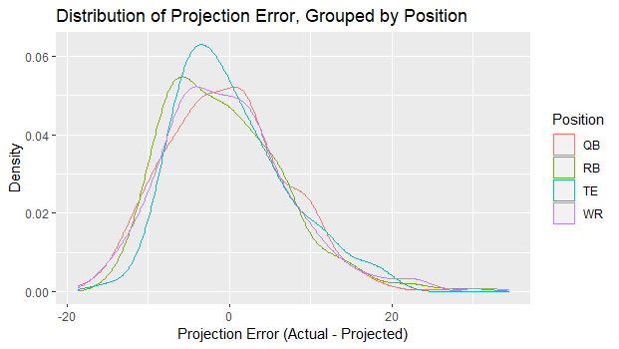
ggplot(scoring_no_inj, aes(x = Proj_error, color = Pos)) + geom_density() +
labs(x = "Projection Error (Actual - Projected)", y = "Density", color = "Position") +
ggtitle("Distribution of Projection Error, Grouped by Position")

Slide 7
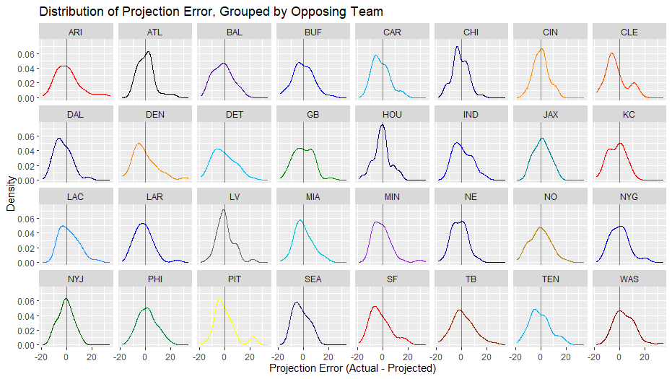
ggplot(scoring_no_inj, aes(x = Proj_error, color = Opp)) + geom_density() + facet_wrap( ~ Opp, nrow = 4) +
labs(x = "Projection Error (Actual - Projected)", y = "Density") +
ggtitle("Distribution of Projection Error, Grouped by Opposing Team") +
geom_vline(xintercept = 0, alpha = 0.5) +
scale_color_manual(values = team_colors) + theme(legend.position = "none")

Slide 8
Calculating Summary Statistics for Each Player’s Projection Errors
scoring_no_inj %>% group_by(Name) %>%
summarize(Weeks_played = n(), Pos = last(Pos), Team = last(Team),
Avg_Projected = mean(Projected),
Avg_Actual = mean(Actual),
Mean = mean(Proj_error),
Var = var(Proj_error)) -> player_data
t(data.frame(lapply(split(scoring_no_inj, scoring_no_inj$Name),
function(X) cor(X$Projected, X$Actual)))) -> player_pred
as.vector(player_pred) -> player_pred
player_data %>%
mutate(Cor = player_pred) %>%
filter(!is.na(Cor)) -> player_data

Slide 9


Biggest Overperformer
Biggest Underperformer
Keenan Allen : WR, Los Angeles Chargers
Patrick Mahomes : QB, Kansas City Chiefs
Averages
Projected: 17.75 pts
Actual: 23.21 pts (6th most in NFL)
Projection Error: +5.46 pts
Averages
Projected: 22.55 pts (most in NFL)
Actual: 19.02 pts
Projection Error: -3.53 pts
*min 10 games with 10+ projected fantasy points

Slide 10
Performing Kruskal-Wallis Tests
kruskal.test(scoring_no_inj$Proj_error, scoring_no_inj$Week)
P-value: 0.008159
kruskal.test(scoring_no_inj$Proj_error, scoring_no_inj$Opp)
P-value: 0.03426
kruskal.test(scoring_no_inj$Proj_error, scoring_no_inj$Pos)
P-value: 0.5728

Slide 11
Some Linear Models Used
m1 <- lm(Actual ~ Projected + Pos + Opp, data = scoring_no_inj)
m2 <- lm(Actual ~ Projected + Name + as.numeric(as.character(Week))*Opp + Pos*Opp,
data = scoring_no_inj)
m3 <- lm(Actual ~ Projected + Name + Week:Opp,
data = scoring_no_inj)
m4 <- lm(Actual ~ Projected + Name + as.numeric(as.character(Week)):Opp,
data = scoring_no_inj)
m5 <- lm(Actual ~ Projected + Name + Pos:Opp,
data = scoring_no_inj)
m6 <- lm(Actual ~ Projected + Name + Week:Opp + Pos:Opp,
data = scoring_no_inj)
m7 <- lm(Actual ~ Projected + Name + as.numeric(as.character(Week)) + Pos:Opp,
data = scoring_no_inj)

Slide 12
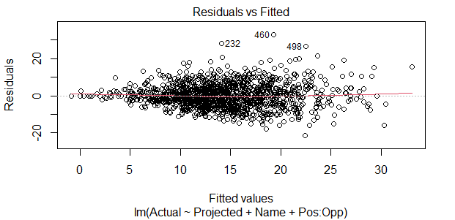
Best linear model I could find
m5 <- lm(Actual ~ Projected + Name + Pos:Opp, data = scoring_no_inj)
RMSE of training data: 6.32
MAE of training data: 4.88
RMSE of testing data: 9.38
MAE of testing data: 7.51

Slide 13
Some Mixed Models Used
m8 <- lmer(Actual ~ Projected + (1|Name), data = scoring_no_inj)
m9 <- lmer(Actual ~ Projected + (0 + Projected|Name),
data = scoring_no_inj)
m10 <- lmer(Actual ~ Projected + (1 + Projected|Name),
data = scoring_no_inj)
m11 <- lmer(Actual ~ Projected + (1|Name) + (0 + Projected|Name),
data = scoring_no_inj)
m12 <- lmer(Actual ~ Projected + Opp + (1 + Projected|Name),
data = scoring_no_inj)

Slide 14
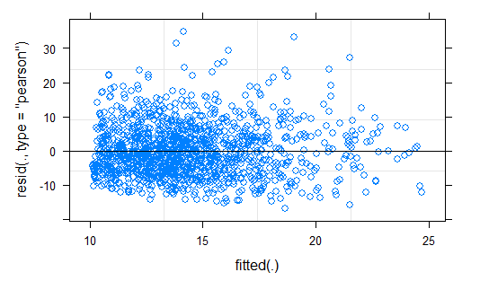
Best mixed model I could find
m10 <- lmer(Actual ~ Projected + (1 + Projected|Name), data = scoring_no_inj)
RMSE of training data: 7.54
MAE of training data: 5.94
RMSE of testing data: 8.68
MAE of testing data: 7.05

Slide 15
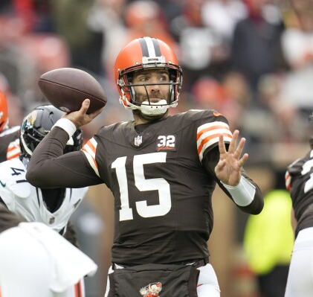


Conclusion

